Slide 1
IBM University Engagement Project Submission
“Exploring the Power of Agentic AI with IBM Granite and LangFlow”

Slide 2

Project Tile – The AI Game Strategy Advisor Agent
Domain of Project – Gaming
Student Name | Recent Passport Photo | Email ID | Mobile number [WhatsApp]
Adarsh Gaidhankar |  | adarsh.gaidhankar@gmail.com | 7058462995

Slide 3
Problem Statement - The AI Game Strategy Advisor Agent
The AI Game Strategy Advisor Agent
The Challenge Modern sports teams rely heavily on strategy and tactical planning. However, analyzing past matches, opponent strategies, and player performance patterns requires extensive manual work by analysts and coaching staff. Many teams lack tools that can quickly analyze historical gameplay data and generate strategic insights. The Objective Build an AI‑powered Game Strategy Advisor Agent that analyzes previous match data, team formations, and opponent strategies to recommend optimized game plans. 1. Match Data Analysis (RAG) :– Retrieve historical match data, formations, and tactical patterns. 2. Opponent Strategy Analysis :– Detect patterns in opponent play styles, strengths, and weaknesses. 3. Tactical Recommendation Engine :– Suggest optimal strategies such as formations, defensive setups, or attacking tactics. 4. Real‑Time Strategic Insights – Provide quick recommendations before or during matches. 5. Multi‑Agent System • Match Analysis Agent – Analyzes historical gameplay data. • Opponent Strategy Agent – Identifies tactical patterns used by opposing teams. • Strategy Recommendation Agent – Suggests optimal game plans. • Insight Explanation Agent – Converts complex analysis into actionable coaching advice. 6. Visualization Dashboard Show team formations, tactical comparisons, opponent weaknesses, and recommended strategies in a clear visual interface. Tech Stack • IBM Langflow / IBM Orchestrate + IBM Models

Slide 4
Proposed Solution -
Proposed Solution: The AI Game Strategy Advisor Agent is an intelligent web-based platform that provides gamers with personalized strategies, gameplay guidance, and real-time recommendations using Artificial Intelligence. Instead of searching through multiple websites, videos, or forums, users can simply describe their game, current challenge, or objective, and the AI will generate tailored advice within seconds.
The system analyzes the user's input—such as the game title, character, level, game mode, or boss encounter—and delivers optimized strategies, character builds, weapon recommendations, team compositions, and tactical tips. It supports players of all skill levels, from beginners seeking basic guidance to experienced gamers looking for advanced competitive strategies.
Key Features
Personalized game strategy recommendations
Character builds and equipment suggestions
Boss fight tactics and walkthroughs
Multiplayer team composition and role recommendations
Meta analysis and gameplay optimization
.

Slide 5
Technology Used
HTML5
HTML5 is used to create the basic structure of the website, including sections, forms, buttons, and content.
CSS3
CSS3 is used to style the website with colors, layouts, animations, and responsive designs for different screen sizes.
JavaScript
JavaScript adds interactivity to the website, such as handling user input, displaying AI responses, and creating dynamic features.
Node.js
Node.js is the backend runtime environment that processes user requests and connects the website to AI services.
OpenAI GPT API
The OpenAI GPT API powers the AI Game Strategy Advisor by understanding user queries and generating personalized game strategies, tips, walkthroughs, and recommendations.
.JSON
JSON (JavaScript Object Notation) is used to exchange data between the client, server, and AI API in a lightweight and readable format

Slide 6
Langflow component Used -
1. Chat Input
The Chat Input component receives the user's message, such as the game name or strategy request, and sends it to the workflow for processing.
2. Prompt Template
The Prompt Template component formats the user's query into a structured prompt, ensuring the AI understands the request and generates accurate responses.
3. OpenAI (LLM)
The OpenAI component uses a Large Language Model (LLM) to analyze the user's input and generate personalized game strategies, walkthroughs, character builds, and gameplay tips.
4. Memory
The Memory component stores the conversation history, allowing the AI to remember previous interactions and provide context-aware responses.
5. Output Parser
The Output Parser component processes the AI-generated response into a clean, readable format before displaying it to the user.
6. Chat Output
The Chat Output component displays the final AI response on the website, enabling users to view strategies and recommendations in a conversational format.

Slide 7

Role of Agentic AI in the solution
Agentic AI plays a key role in making the AI Game Strategy Advisor more intelligent, interactive, and personalized. Unlike traditional chatbots that simply answer questions, an Agentic AI can understand the user's objective, analyze the gaming situation, and provide step-by-step strategic recommendations.
For this project, the Agentic AI performs the following functions:
Understands User Intent: Interprets the player's query, such as defeating a boss, improving rankings, selecting the best character build, or completing a mission.
Provides Personalized Strategies: Generates recommendations based on the user's game, skill level, playstyle, and specific challenges instead of giving generic advice.
Maintains Conversation Context: Remembers previous interactions within the conversation, allowing users to ask follow-up questions without repeating information.
Adapts to Different Games: Supports multiple game genres such as action, adventure, RPG, FPS, sports, and multiplayer games by tailoring responses to each game's mechanics.
Assists in Decision-Making: Compares different weapons, characters, abilities, and tactics to help users choose the most effective option.

Slide 8
Novelty and Uniqueness
Personalized AI Guidance: Generates customized strategies based on the user's game, objective, playstyle, and experience level.
Multi-Game Support: Supports a wide variety of games, including action, RPG, FPS, sports, strategy, and multiplayer titles, through a single platform.
Interactive Conversational Experience: Users can ask follow-up questions and receive detailed explanations instead of relying on fixed guides.
Recommendations: Understands the user's current situation, such as a boss fight, difficult mission, or competitive match, and provides relevant solutions.
Step-by-Step Strategy Generation: Breaks down complex gameplay challenges into simple, actionable steps for better understanding.
Adaptive Learning Experience: Adjusts responses according to whether the user is a beginner, intermediate, or advanced player.
Real-Time AI Assistance: Provides instant recommendations without requiring users to search multiple websites, forums, or videos.

Slide 9
Git Hub Link
https://github.com/adish-sketch/AI-Game-Strategy-Advisor.
·
·
·

Slide 10
Future Scope
The AI Game Strategy Advisor Agent has significant potential for future enhancement by incorporating advanced AI capabilities and expanding its range of gaming support. As gaming technologies evolve, the platform can become a comprehensive AI-powered gaming companion.
Future Enhancements
Voice-Based AI Assistant: Enable users to interact with the AI using voice commands for a hands-free gaming experience.
Real-Time Gameplay Analysis: Analyze live gameplay or screen recordings and provide instant strategy suggestions.
Image and Screenshot Analysis: Allow users to upload screenshots of game levels, maps, or bosses to receive AI-generated solutions.
Multiplayer Team Coordination: Recommend team compositions, player roles, and strategies for cooperative and competitive multiplayer games.
Personalized Learning: Track player performance over time and provide customized training plans to improve gaming skills.
Integration with Popular Gaming Platforms: Connect with platforms such as Steam, Epic Games, PlayStation, Xbox, and Nintendo to offer personalized recommendations based on the user's game library.
·
·
·

Slide 11
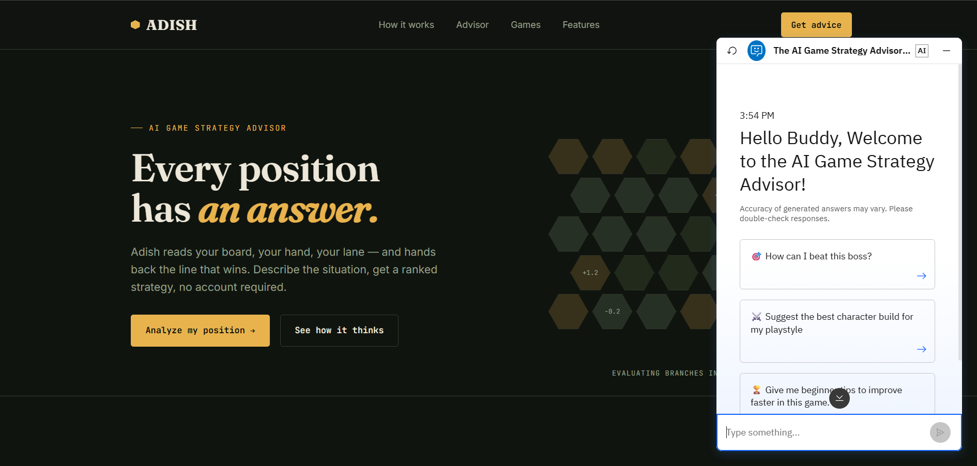

Slide 12
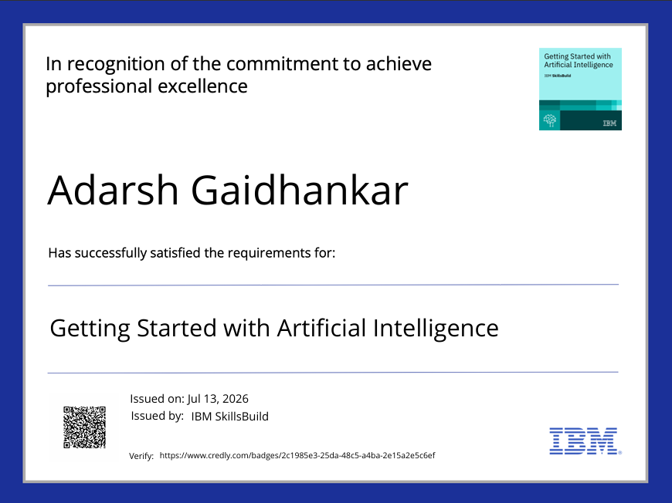
Certificates Earned:

Slide 13
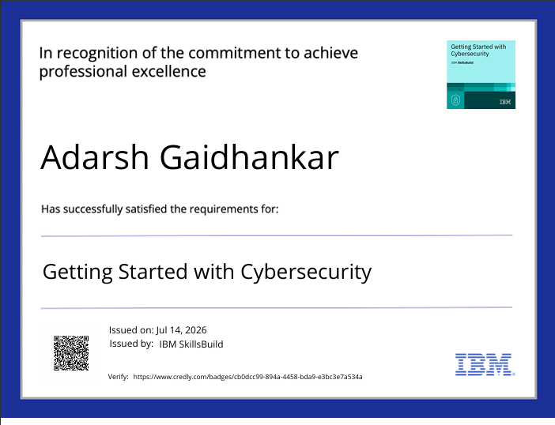
Certificates Earned:

Slide 14
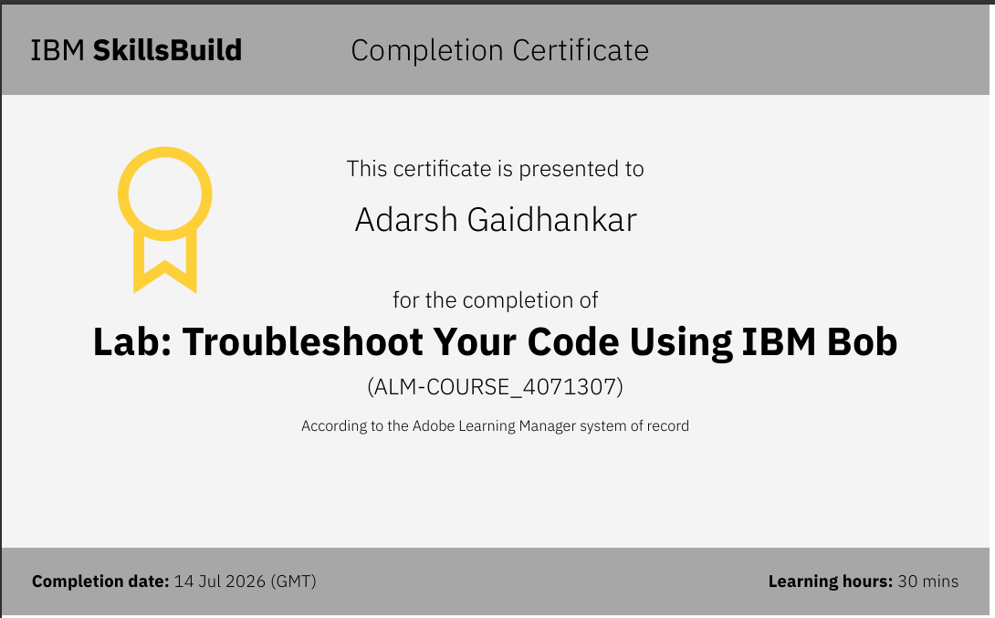
Certificates Earned:​

Slide 15


